Slide 1
Multi-Target Tracking with GPU-Accelerated Data Association Engine
Samiran Kawtikwar
Rakesh Nagi
Department of Industrial and Enterprise Systems Engineering,
University of Illinois at Urbana-Champaign,
Illinois, USA
6/30/23

Slide 2
Background
Our Solutions
Evaluation

Slide 3
Introduction: Multi Target Tracking (MTT)
Input: time indexed sensor/radar scans
(Colors are unknown to the sensor)
Output:
Track of each target
The Data association problem:
Identify set of observations or measurements generated by the same target

Slide 4
Literature: Multi Target Tracking (MTT)
Multiple Hypothesis Tracking (MHT) and its extensions:
Reid 1979, Bar-Shalom and Li 1995, Shapero et al. 2016
Joint Probabilistic Data Association (JPDA):
Bar-Shalom and Li 1995
Our focus:
Mathematical Programming Formulations and Associated Heuristics
Morefield 1977, Poore and Rijavec 1993, Deb et al. 1994, Poore 1994, Gauvrit et al. 1996, Poore 2000, Popp et al. 2001, Kirubarajan et al. 2001, Sahoo et al. 2013

Slide 5
Literature: Mathematical Programming Formulations
Typically Modelled as a Multidimensional Assignment Problem:
Minimize assignment costs
Subject to assignment constraints
Ensure transitivity with triplet costs
Difficulties:
MAP is NP hard (time complexity exponential in input size)
Handling abnormalities: (missed detections, false alarms, birth and death of targets)

Slide 6
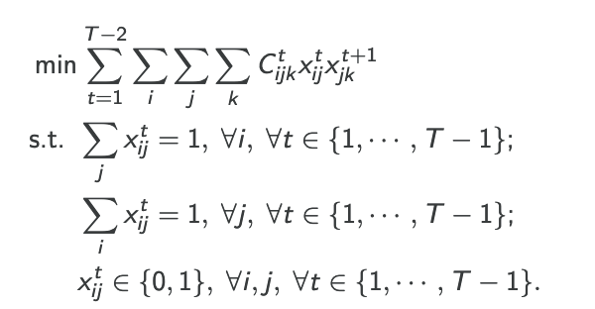
Multi Target Tracking Formulation [Arora and Globerson, 2013]
Our past work
Spline interpolation-based triplet costs with linearized MAP formulation
[Date and Nagi, Fusion 18]
MDADC vs linearized MAP
[Reynen, Vadrevu, and Nagi Fusion 19]
Dual Ascent algorithm for linearized MAP
[Vadrevu, and Nagi Fusion 20]
GPU accelerated MTT (This talk)

Slide 7
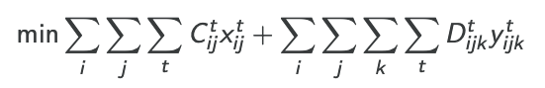
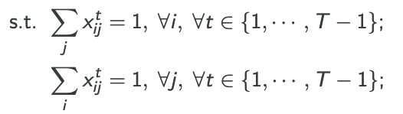
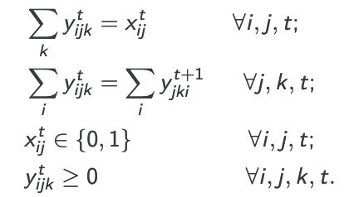
Linearized MAP formulation [Date and Nagi, 2018]
The formulation can be linearized by using the lifted y variable

Slide 8
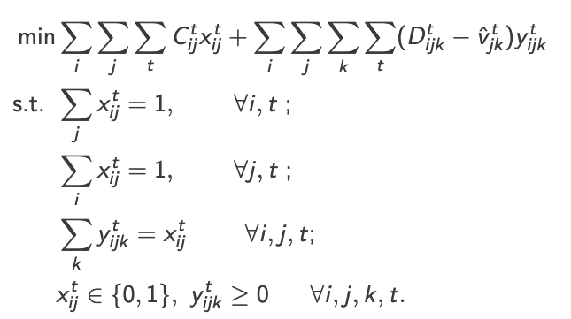
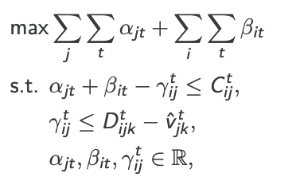
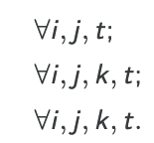
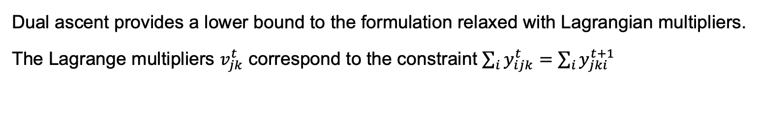
Dual Ascent for MAP [Vadrevu and Nagi, 2020]
Dual ascent provides a lower bound to the formulation relaxed with Lagrangian multipliers.
The Lagrange multipliers $v_{jk}^{t}$ correspond to the constraint $\sum_{i}{y_{ijk}^{t}}=\sum_{i}{y_{jki}^{t+1}}$
Dual
The dual problem is decomposable!
Based on which a dual ascent algorithm is designed

Slide 9
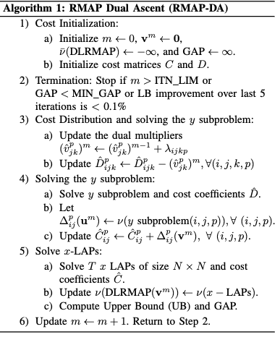
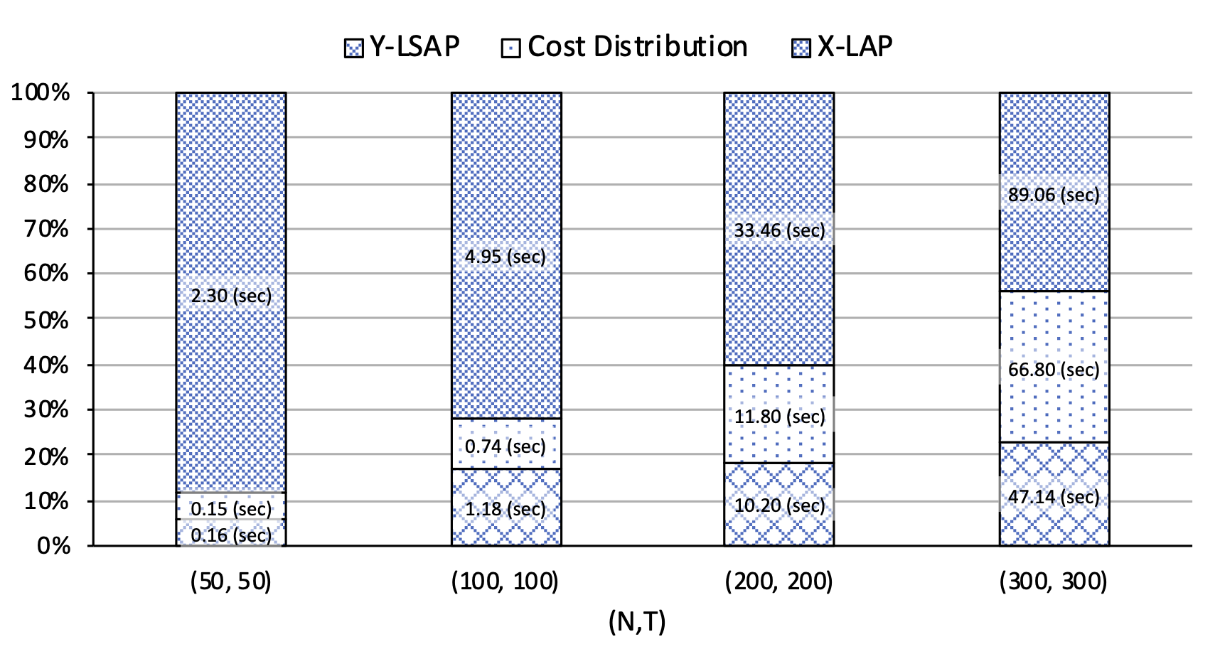
Dual Ascent for MAP [Vadrevu and Nagi, 2020]
Relative time for each step in Dual Ascent
This paper: We accelerated this algorithm using GPUs

Slide 10
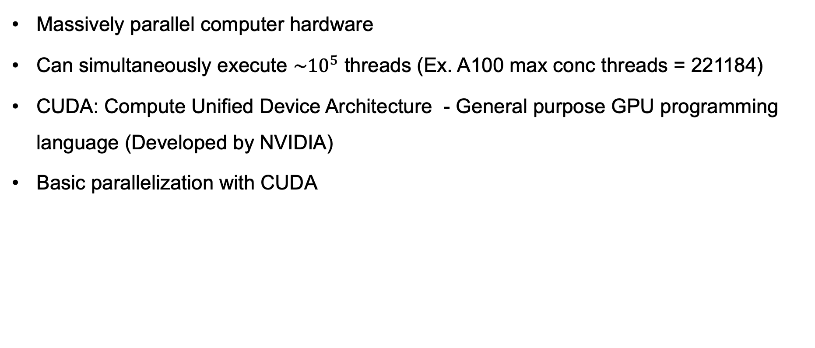
Intro to Graphics Processing Units (GPUs)
Massively parallel computer hardware
Can simultaneously execute $\sim {10}^{5}$ threads (Ex. A100 max conc threads = 221184)
CUDA: Compute Unified Device Architecture - General purpose GPU programming language (Developed by NVIDIA)
Basic parallelization with CUDA
T0 | T1 | T2 | T3 | T4
a
1 | 4 | 3 | 5 | 2
b
2 | 8 | 6 | 10 | 4
a + b
3 | 12 | 9 | 15 | 6

Slide 11
Background
Our Solutions
Evaluation

Slide 12
Our Solution
We developed:
Multi threaded cost generator using spline interpolation and gating
Block Linear Assignment Problem (LAP) solver for solving X-LAPs using GPU
A compressed cost distribution kernel for faster dual ascent cost transfer

Slide 13
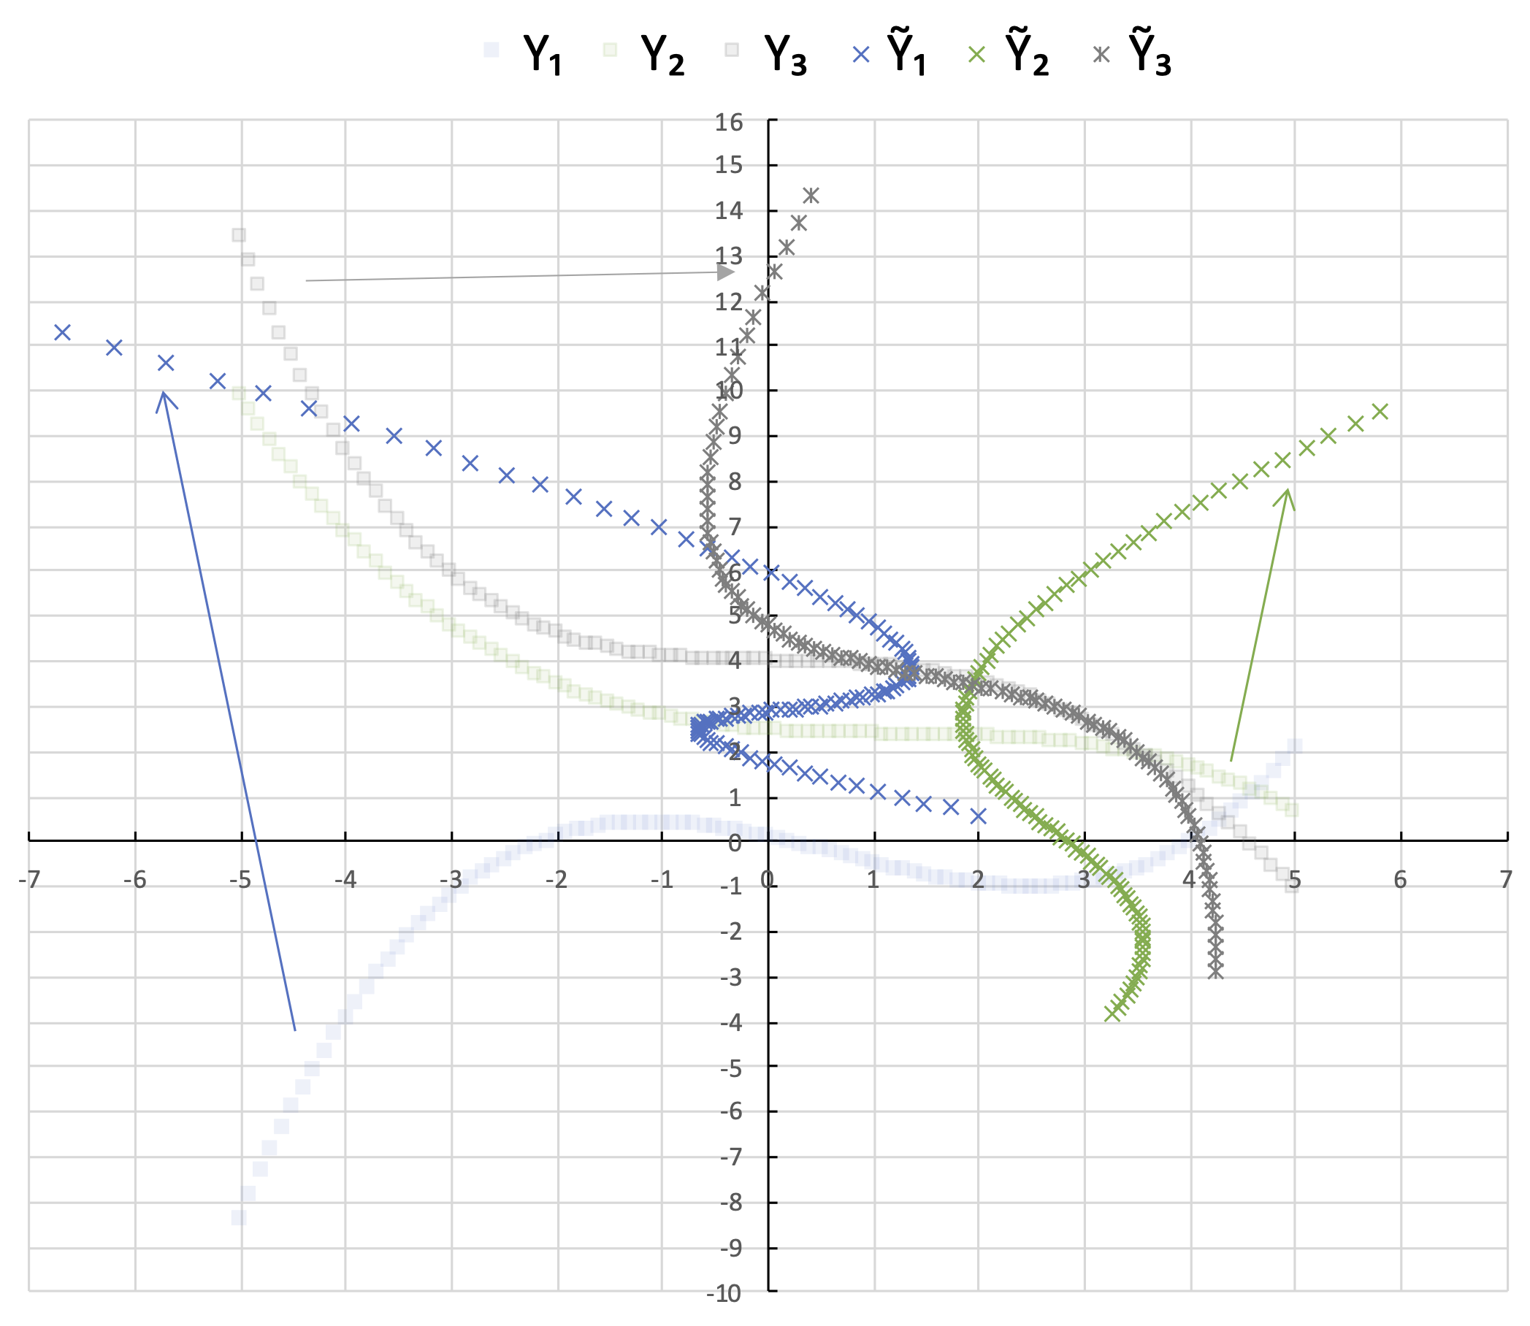
Multi threaded cost generator
Generating scores efficiently is an important part of the MTT engine, since it is performed in real time.
We use spline interpolation-based costs for realistic cost estimation for maneuverable targets (with the alglib package).
Coarse granularity: Each thread (in CPU) calculates costs for a particle at every time frame.
Fig. Example particle trajectories

Slide 14
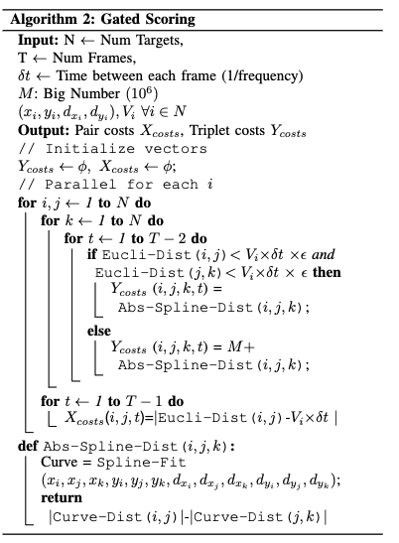
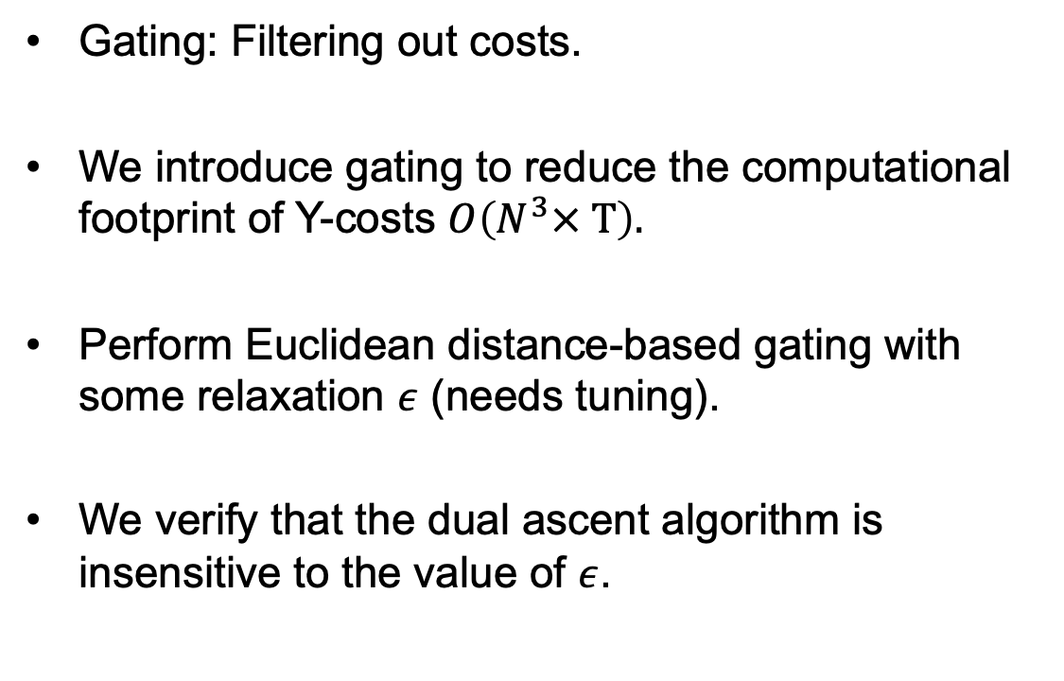
Multi threaded cost generator
Gating: Filtering out costs.
We introduce gating to reduce the computational footprint of Y-costs $O\left(N^{3}× T\right).$
Perform Euclidean distance-based gating with some relaxation $ε$ (needs tuning).
We verify that the dual ascent algorithm is insensitive to the value of $ε$.

Slide 15


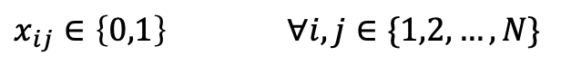
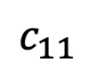

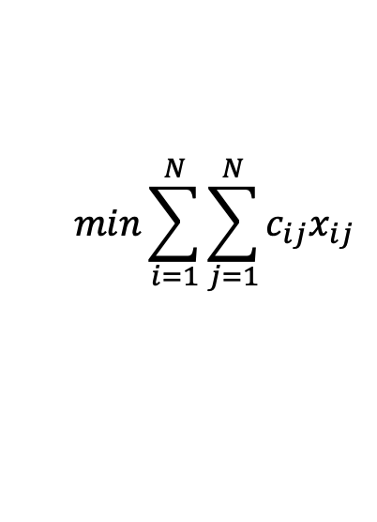

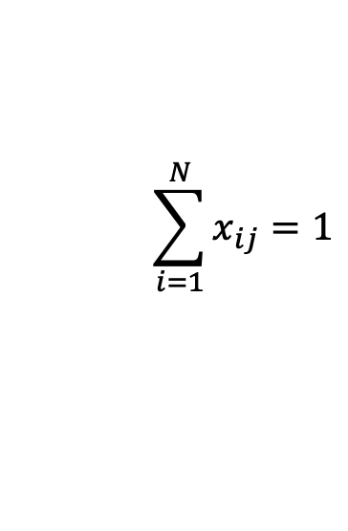
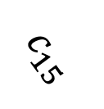
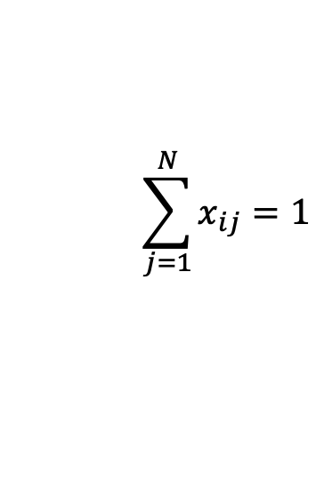
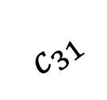
Block Linear Assignment Problem (LAP) solver
$$c_{11}$$
$$min\sum_{i=1}^{N}{\sum_{j=1}^{N}{c_{ij}x_{ij}}}$$
1
1
$$c_{31}$$
2
2
$$\sum_{j=1}^{N}{x_{ij}}=1$$
$$∀i∈\{1,2,…,N\}$$
3
3
$$c_{15}$$
4
$$\sum_{i=1}^{N}{x_{ij}}=1$$
4
$$∀j∈\{1,2,…,N\}$$
5
5
$x_{ij}∈\left\{0,1\right\}$ $∀i,j∈\{1,2,…,N\}$

Slide 16
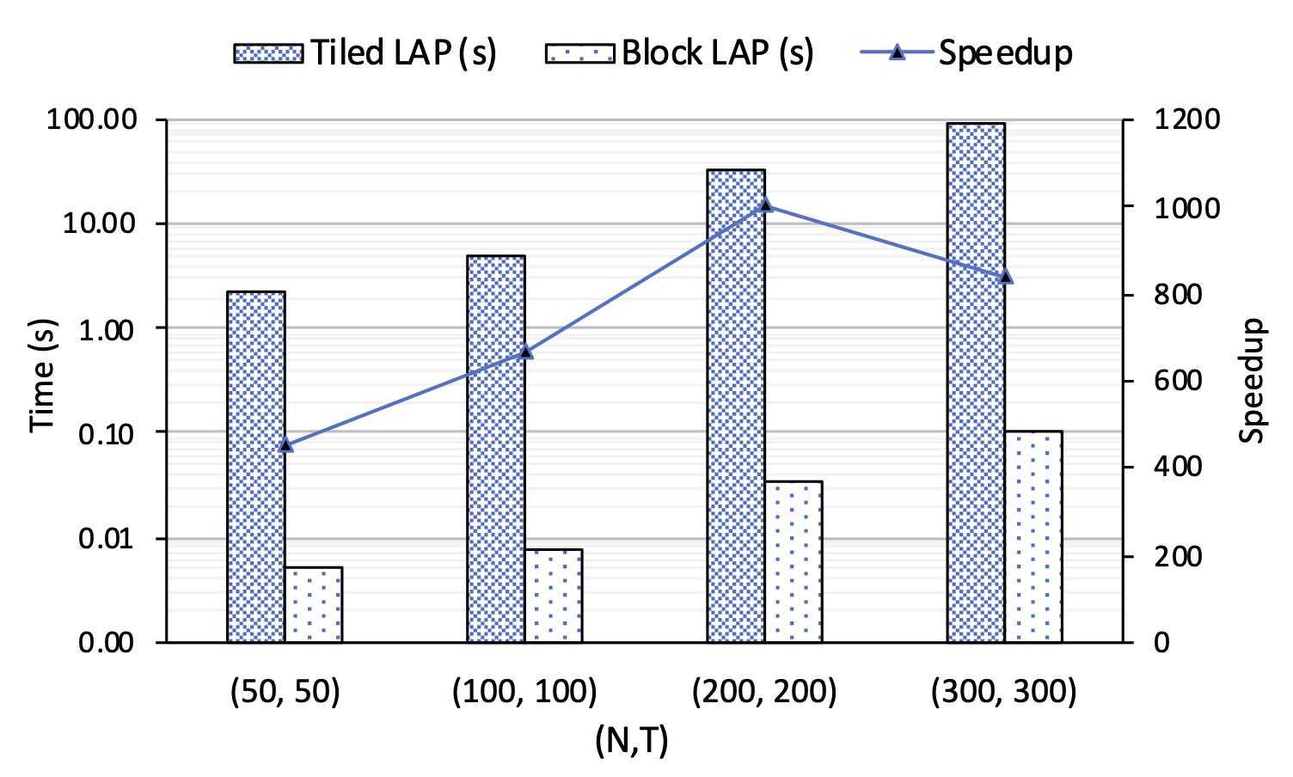
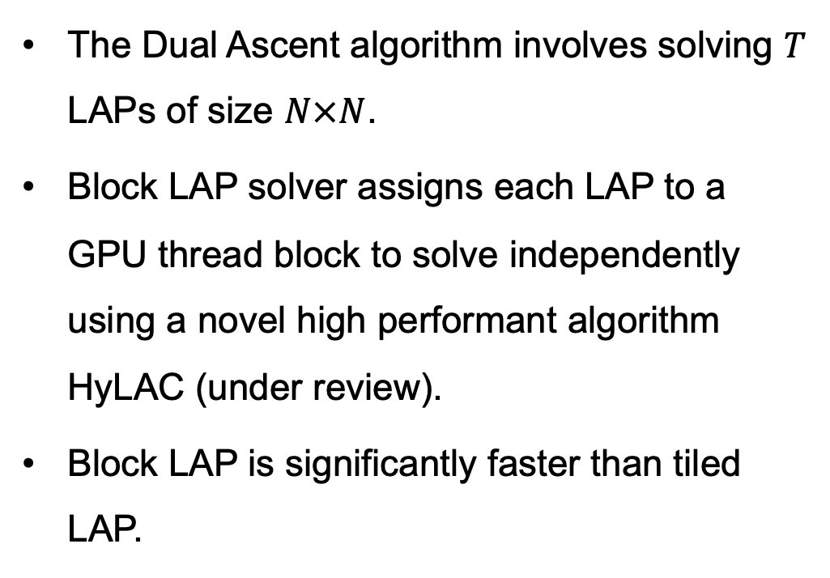
Block Linear Assignment Problem (LAP) solver
The Dual Ascent algorithm involves solving $T$ LAPs of size $N×N$.
Block LAP solver assigns each LAP to a GPU thread block to solve independently using a novel high performant algorithm HyLAC (under review).
Block LAP is significantly faster than tiled LAP.
Speedups with block LAP solver mean ~$708×$

Slide 17
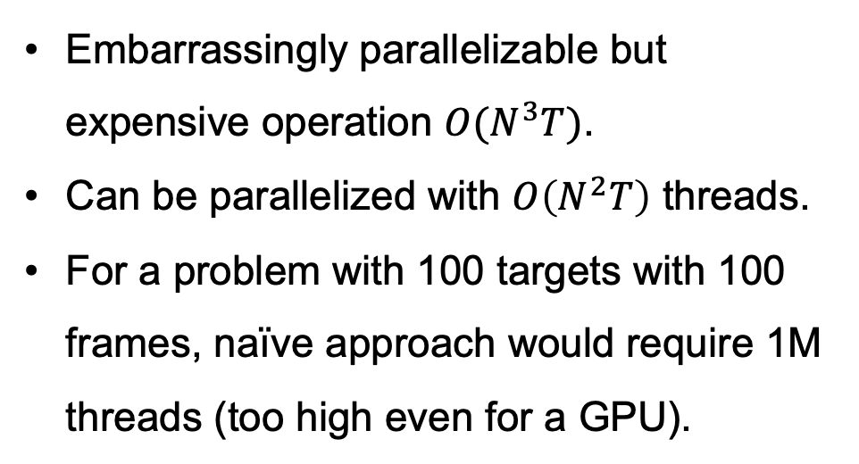
Compressed Cost Distribution
Embarrassingly parallelizable but expensive operation $O(N^{3}T)$.
Can be parallelized with $O\left(N^{2}T\right)$ threads.
For a problem with 100 targets with 100 frames, naïve approach would require 1M threads (too high even for a GPU).
Solution:
Many costs are too high and never contribute to the solution (based on gating)
Use compression and only store meaningful costs

Slide 18
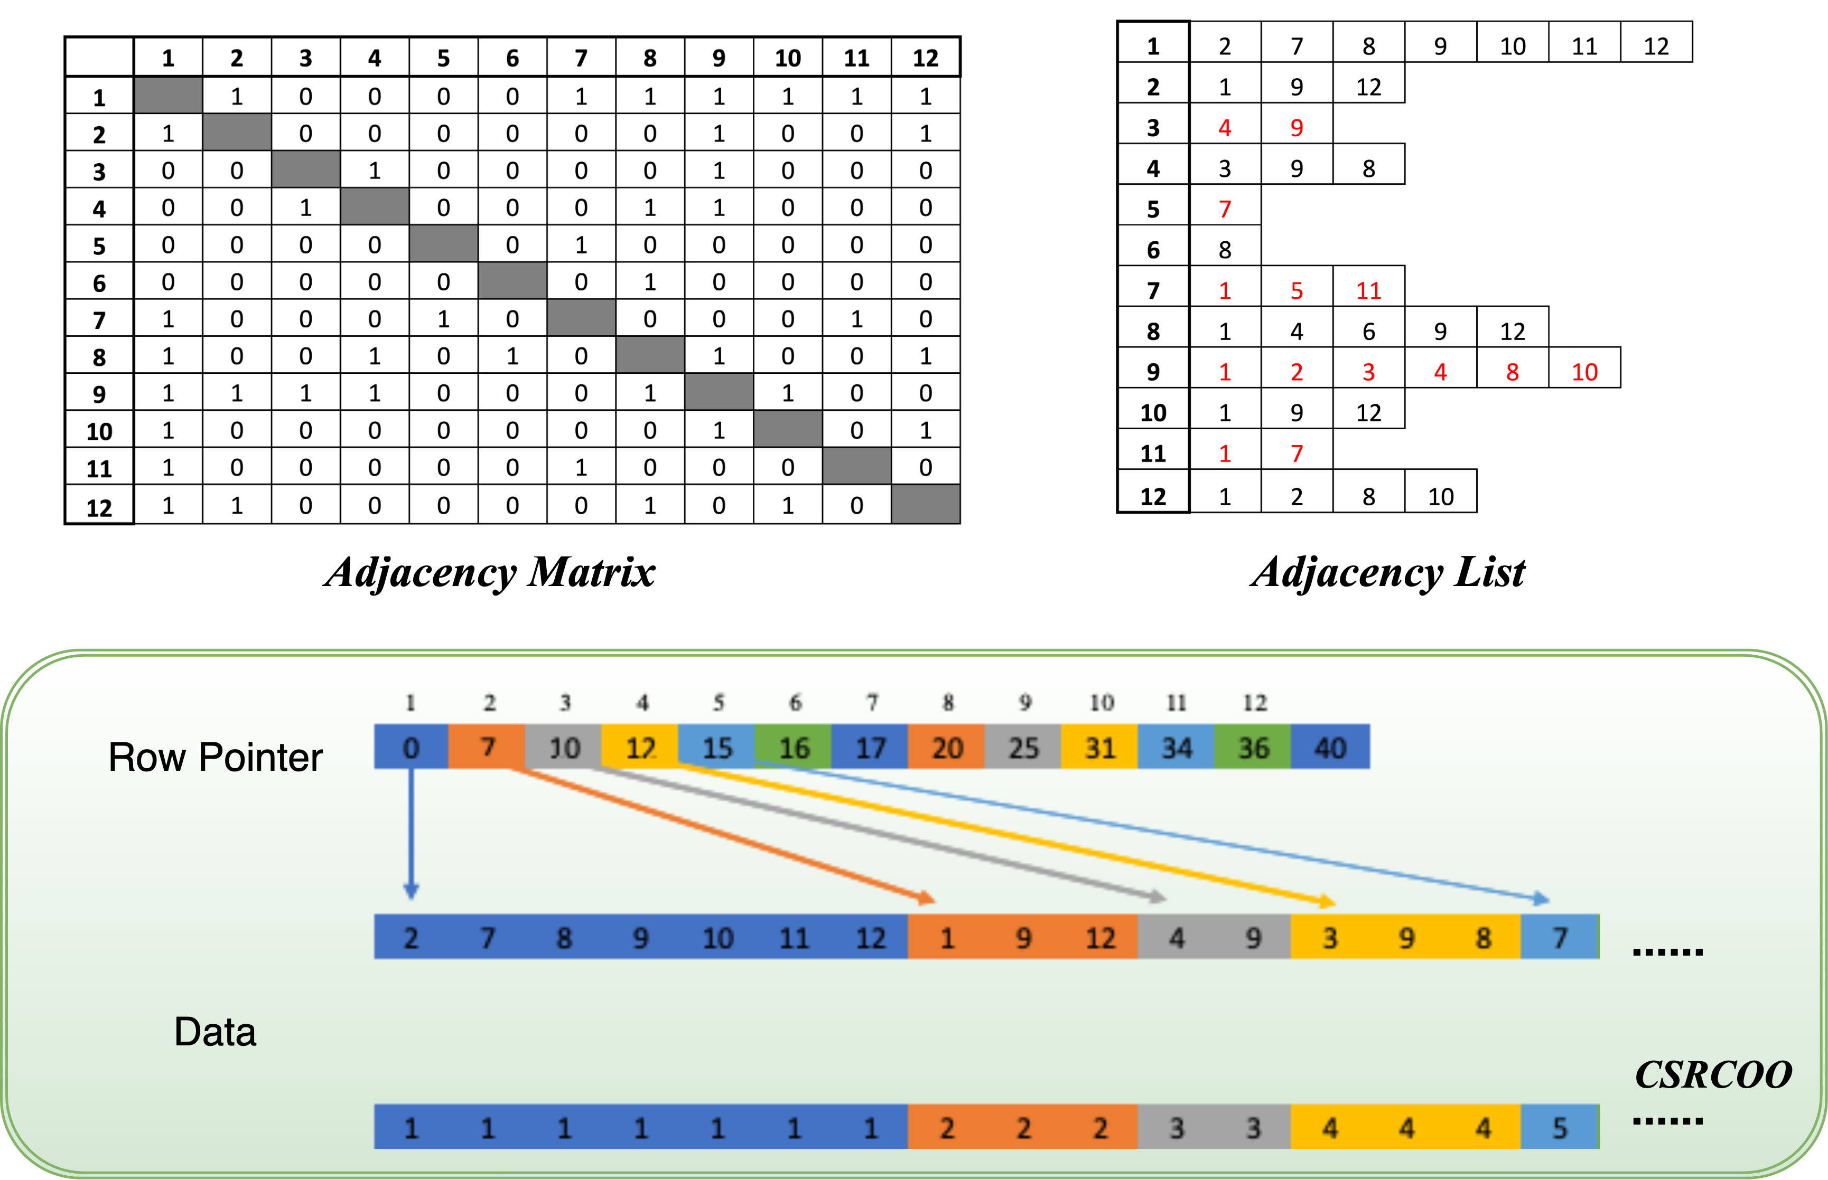
Compressed Cost Distribution
Compressed Sparse Row Coordinate (CSRCOO) format is used for compression.

Slide 19
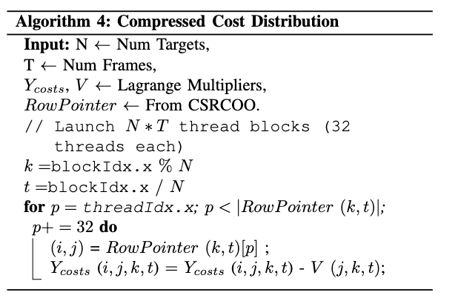
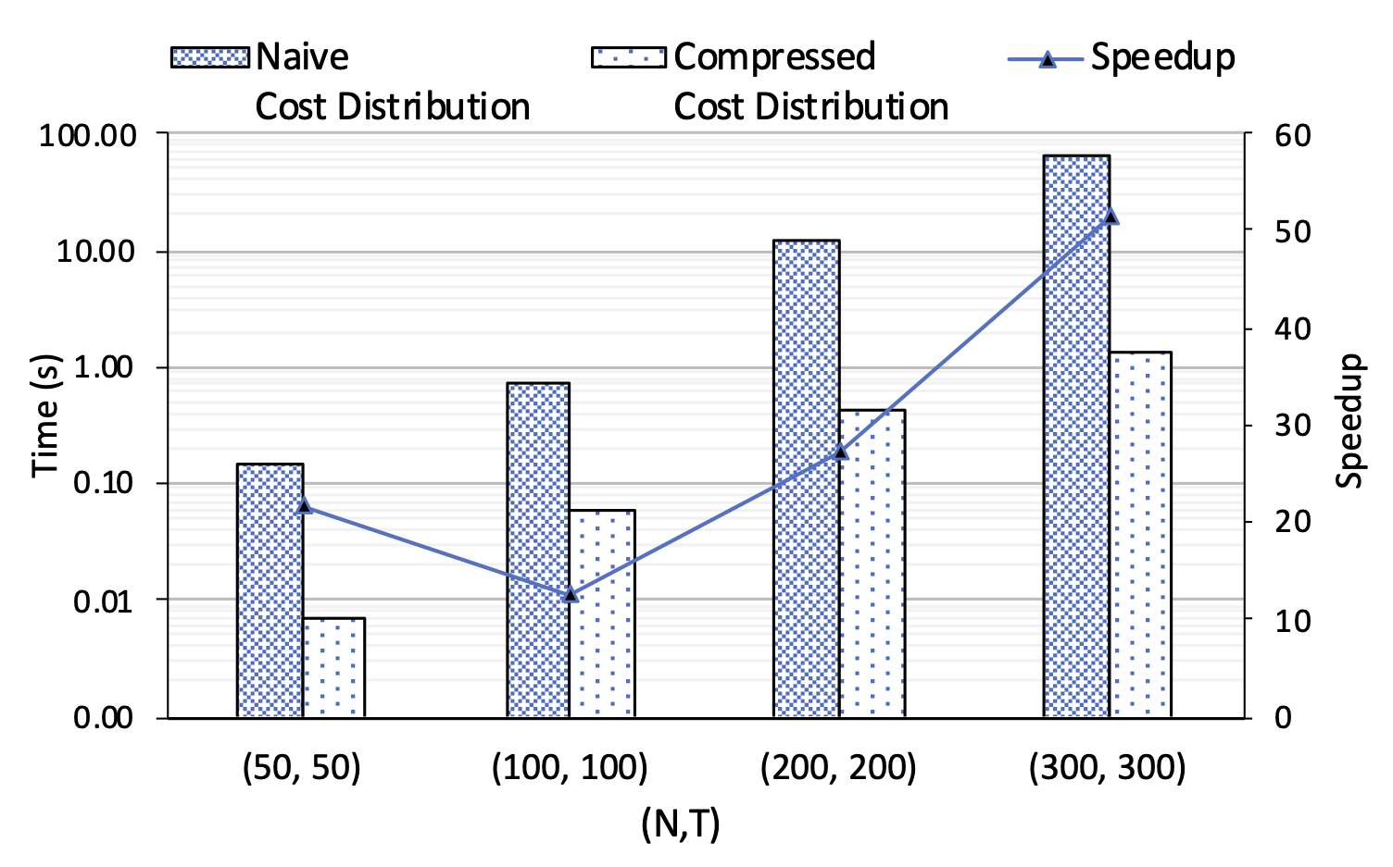

Compressed Cost Distribution
Speedups with compressed cost distribution
Mean ~$24.7×$

Slide 20
Background
Our Solutions
Evaluation

Slide 21
Performance Evaluation
Criteria:
MMEP (Mismatch Error Percentage), ITCP (Incorrect Trajectory Count Percentage)
Computational platform:
A100 GPU with 80GB high bandwidth memory
AMD EPYC 7413 24 core CPU with 128 GB DDR4 RAM
Baseline:
Vadrevu and Nagi, Fusion 2020

Slide 22
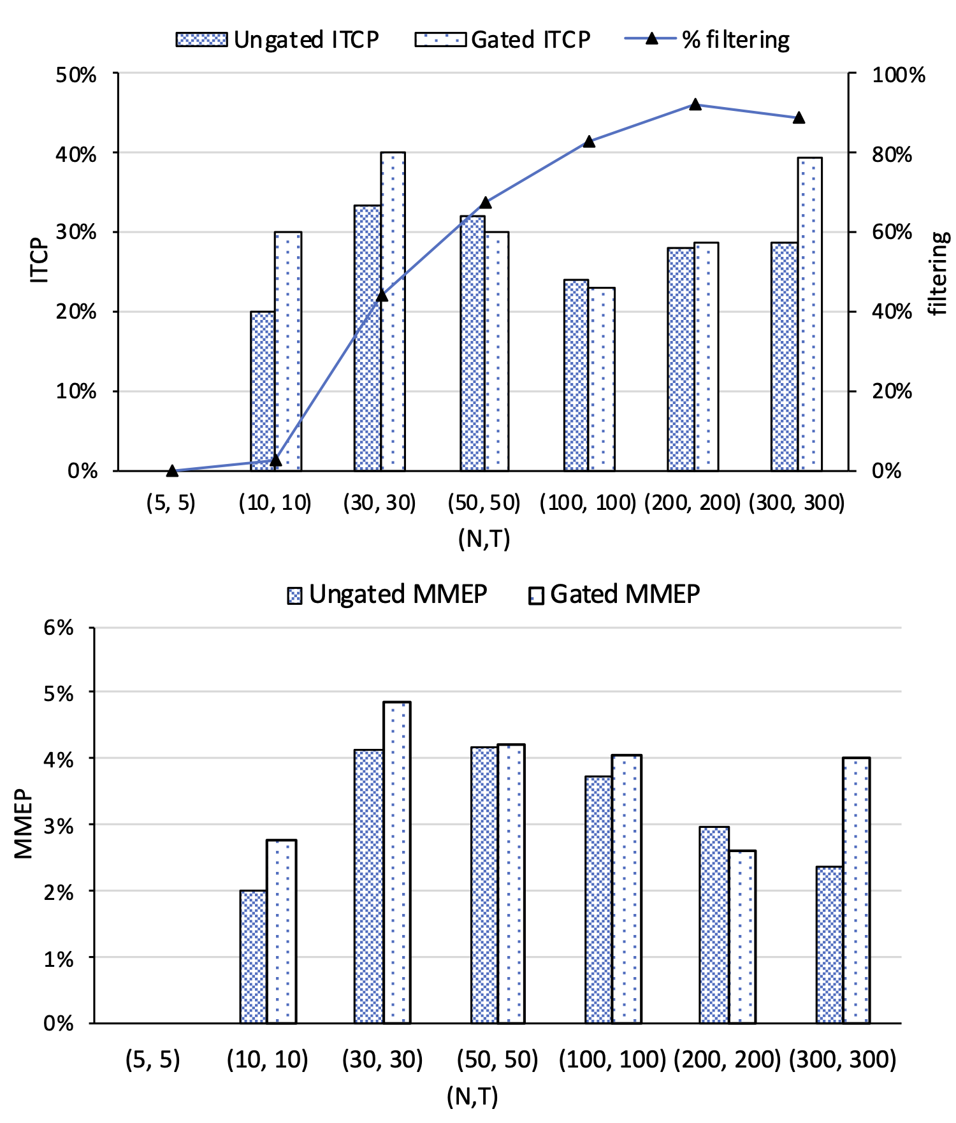
Performance Evaluation: Solution accuracy with gating
Comparing ITCP and MMEP scores with and w/out gating

Slide 23
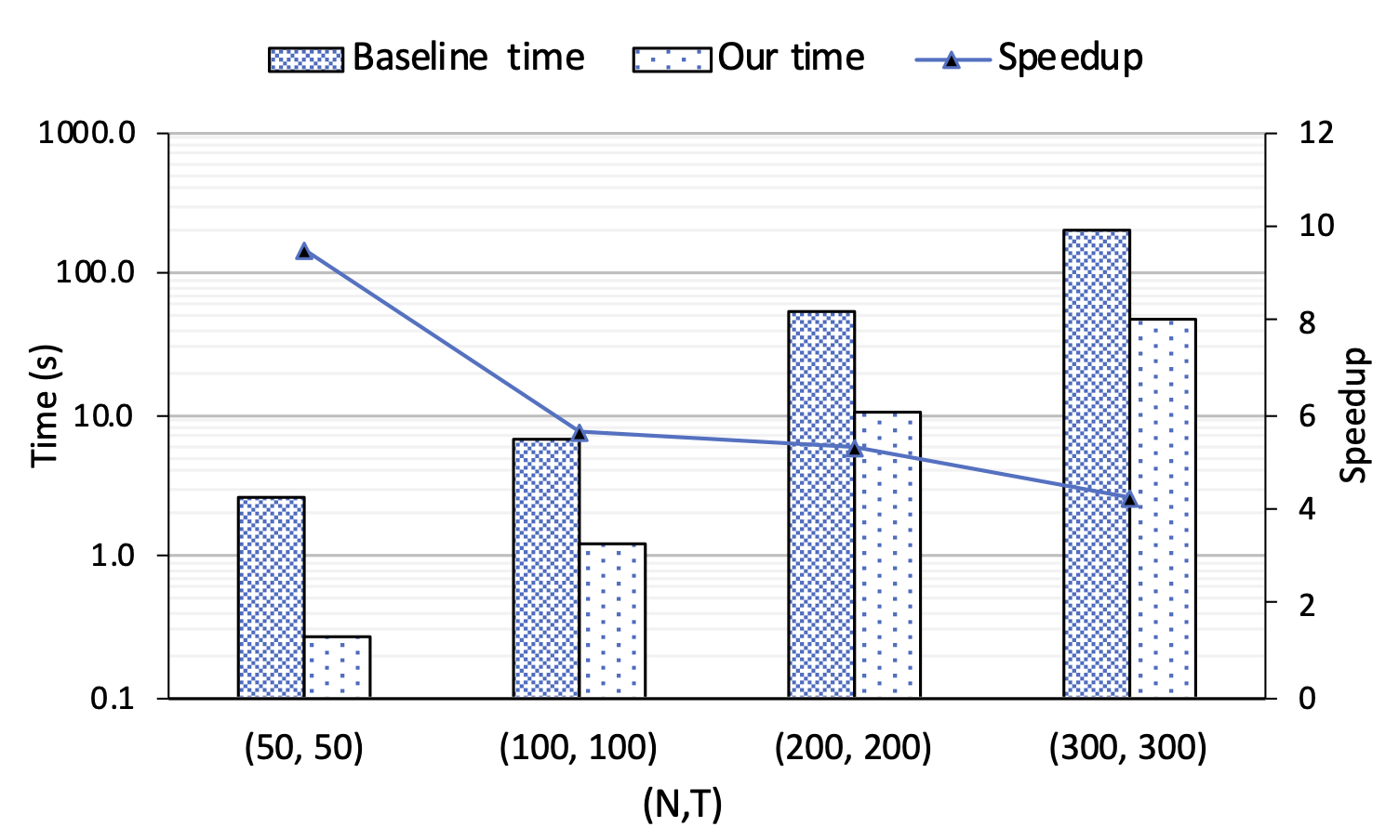
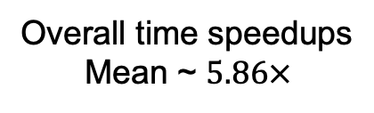
Performance Evaluation: Solution times
Overall time speedups
Mean ~ $5.86×$

Slide 24
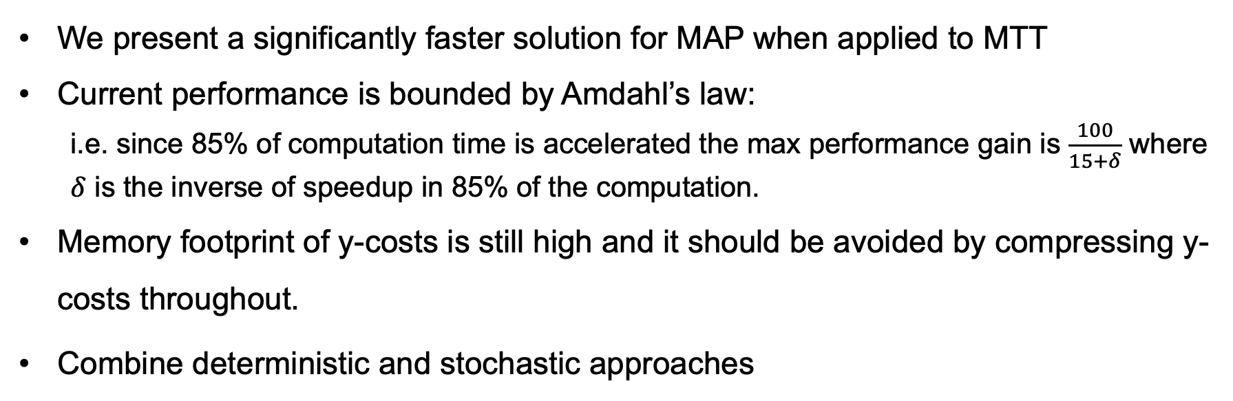
Conclusions and future work
We present a significantly faster solution for MAP when applied to MTT
Current performance is bounded by Amdahl’s law:
i.e. since 85% of computation time is accelerated the max performance gain is $\frac{100}{15+δ}$ where $δ$ is the inverse of speedup in 85% of the computation.
Memory footprint of y-costs is still high and it should be avoided by compressing y-costs throughout.
Combine deterministic and stochastic approaches

Slide 25
Thank you!
Questions?
samiran2@Illinois.edu
Acknowledgements
This research is a part of the Delta research computing project, which is supported by the National Science Foundation (award OCI 2005572), and the State of Illinois. Delta is a joint effort of the University of Illinois at Urbana-Champaign and its National Center for Supercomputing Applications.
We are grateful to NVIDIA's Applied Research Accelerator Program for donating two A100 GPUs, which were extremely helpful in the development stages of this work.

